Slide 1
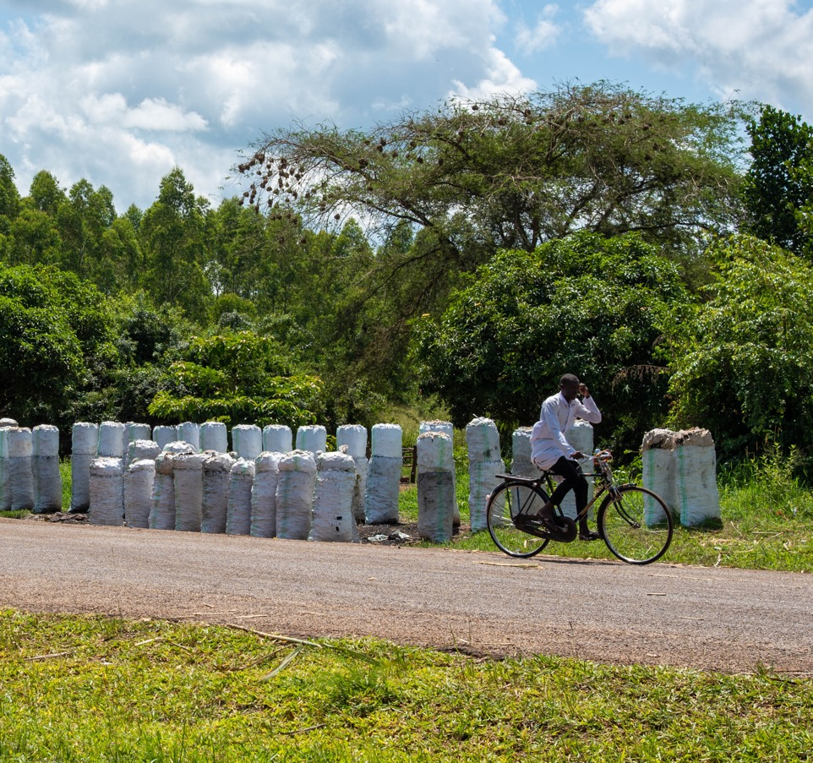



Marginal approach Rob Bailis – SEI Adrian Ghilardi - UNAM
Timothy Akolamazima: CC-BY-SA-4.0
ETHOSCon Jan 24-25, 2025

Slide 2
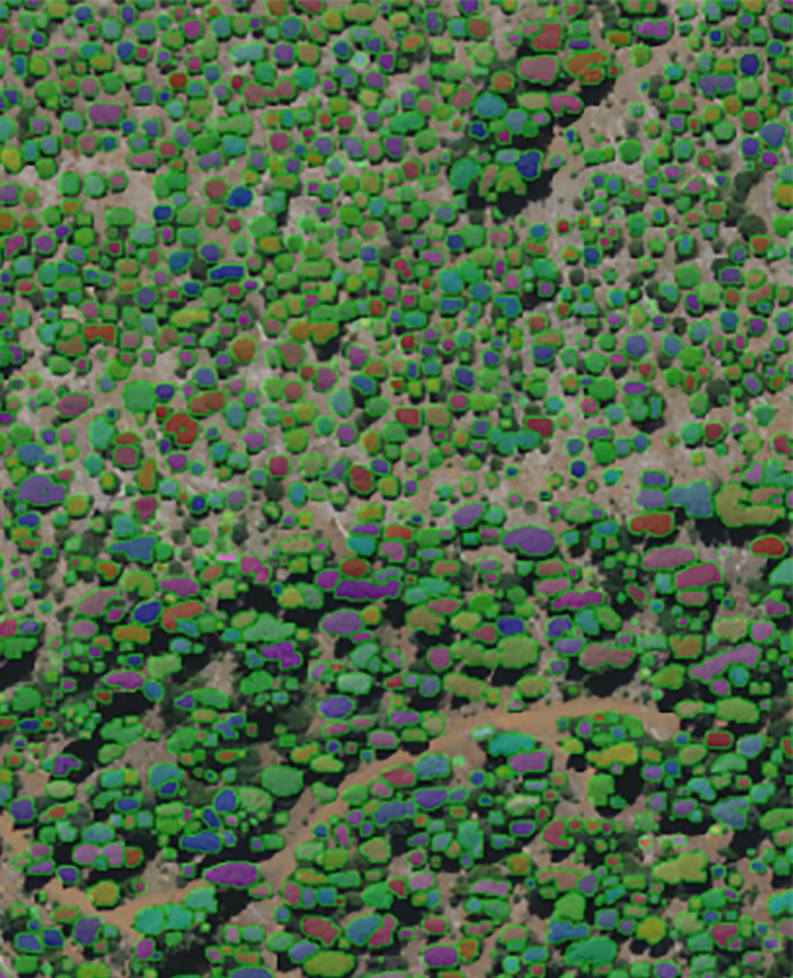
Overview
Uncertainties – Improving MoFuSS
Marginal fNRB – New methods
https://ctrees.org/products/tree-level

Slide 3
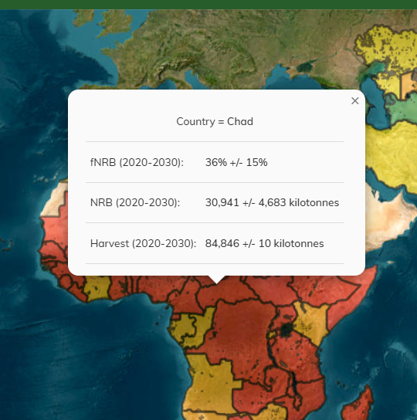
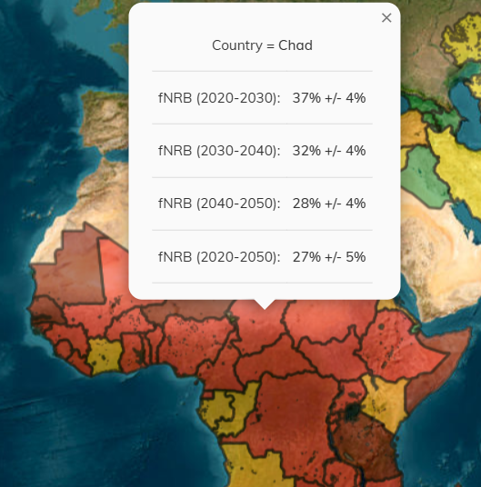

Uncertainties
${SE=SD}/{\sqrt{n}}$ Being n, the number of Monte Carlo realizations

Slide 4
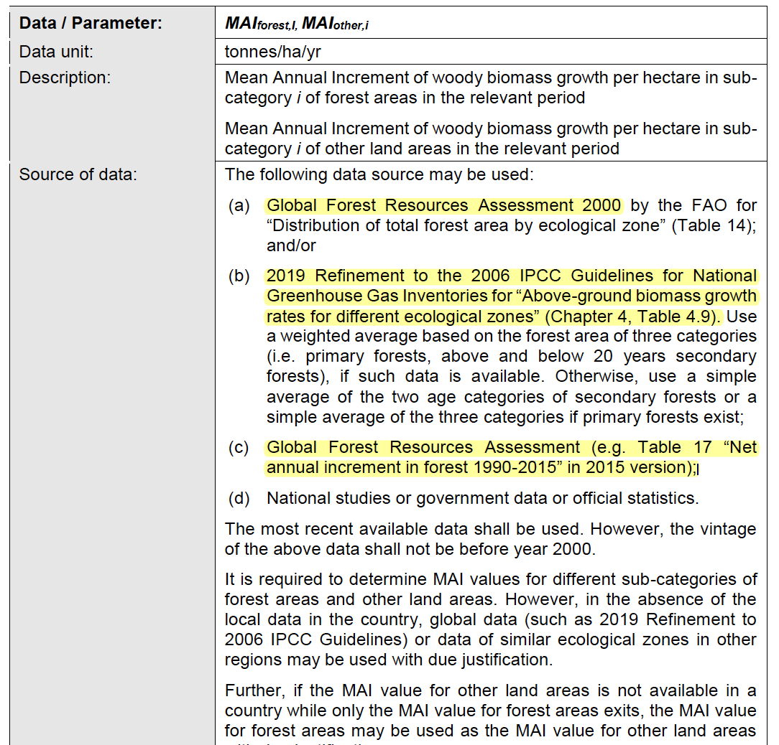
Uncertainty in Tool30
TOOL30 Version 04.0 Data / Parameter table 5 (from Sept, 2022)
Recommended sources of data for forest growth (using mean annual increment – MAI)
To use Tool30, you need to know:
Areas of different types forest
Ideally areas of “trees outside forests” too
Woody biomass growth rates in each forest type
Suggest 3 possible sources as well as “National studies or government data or official statistics”
Woodfuel demand (not covering today)

Slide 5
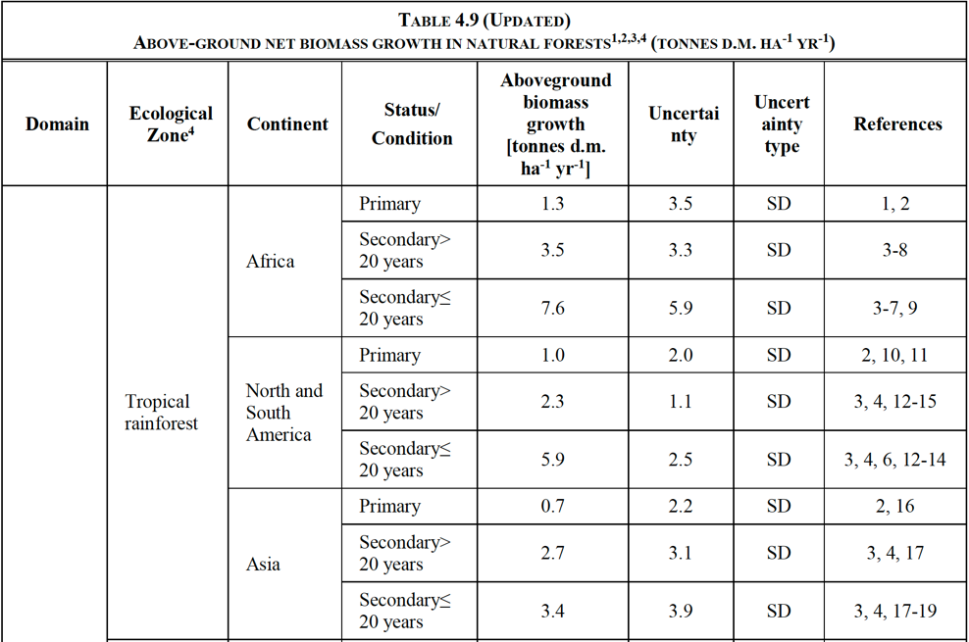
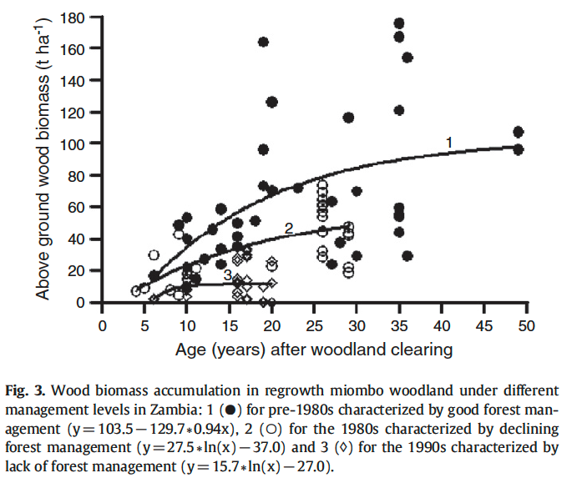
Uncertainty in Tool30
From IPCC’s “2019 Refinement to the 2006 IPCC Guidelines for National Greenhouse Gas Inventories”
2. IPCC AGB growth rates
(re)growth rates are not constant
Very variable
Higher in young and recently disturbed stands
Uncertainty is included, but Tool30 ignores it

Slide 6
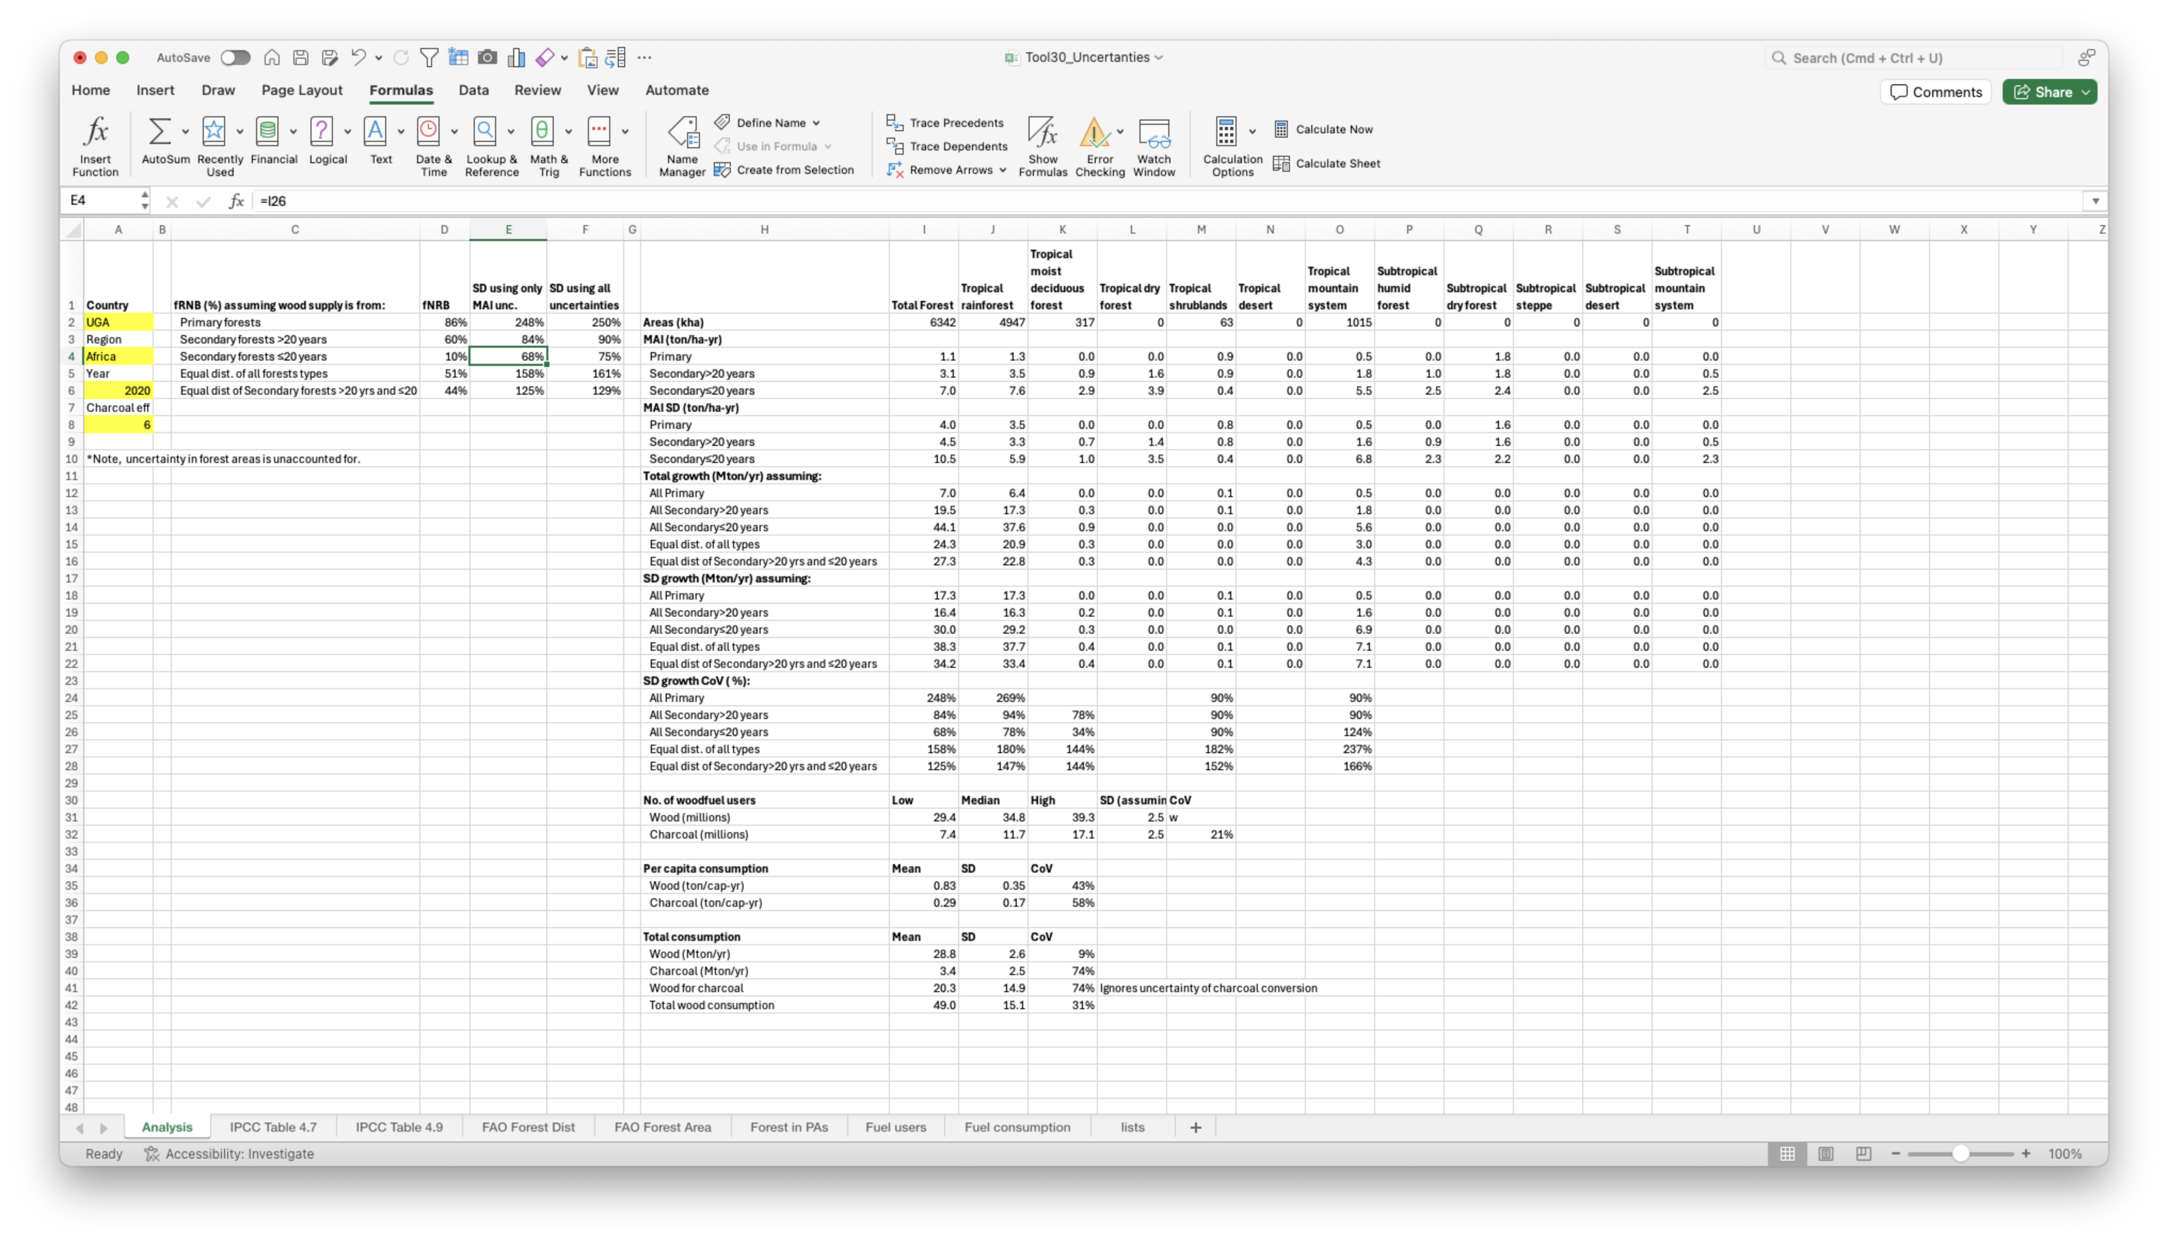
Uncertainty in Tool30 – how large is it?
We built a simple excel model using data recommended by Tool30 to calculate the uncertainty in fNRB using Standard Deviations in MAI from the IPCC

Slide 7
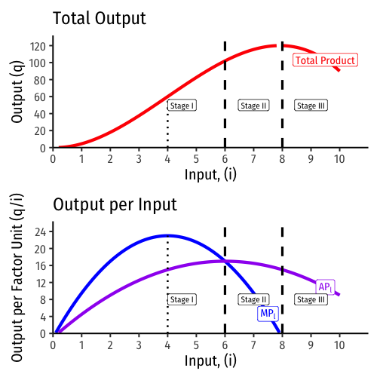
Marginal fNRB
What the heck are we talking about?
Common in Economics
The effect of a unit change in one variable on another variable
Utility, Cost/Revenue, Productivity
Output is a non-linear function of inputs like capital and labor (top graph)
An additional unit of input affects output differently depending on the quantity of inputs already being utilized (lower graph - blue line)
https://thoughtf20.classes.ryansafner.com/slides/3.2-slides#26

Slide 8
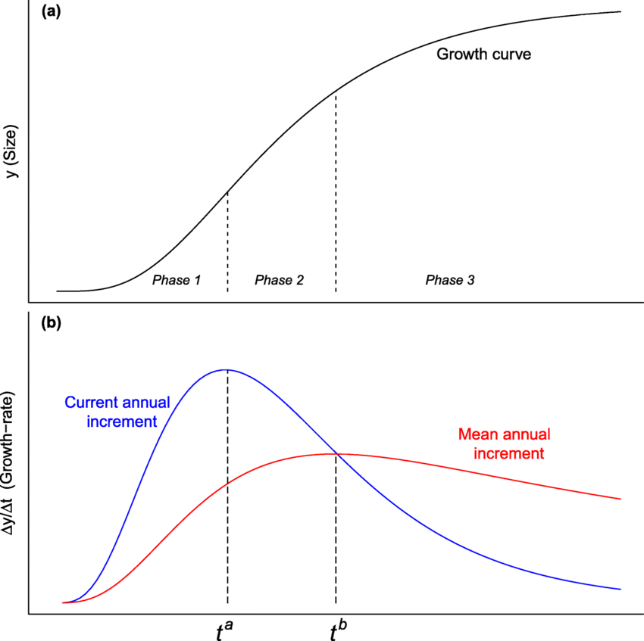

Marginal fNRB
How does this apply to trees?
“Output” is woody biomass
MP_{i} is Current Annual Increment (CAI)
Inputs are sunlight, nutrients, and the trees …
“leaves are the forest’s photosynthetic factory”
But its not a direct analogy
These plots show “time”, not inputs
We’re not directly interested the growth curve
We need to know how harvest leads to losses in stock
https://www.researchgate.net/publication/357163700_Growth_Equations_in_Forest_Research_Mathematical_Basis_and_Model_Similarities/figures?lo=1

Slide 9
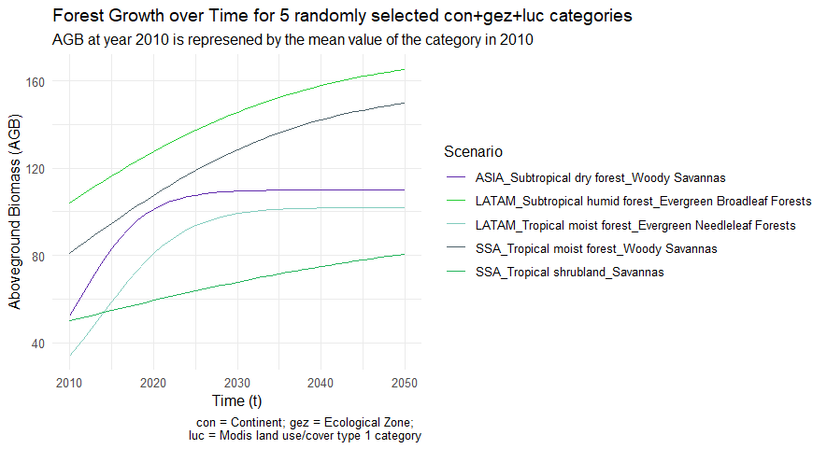
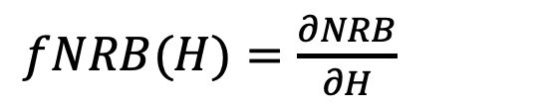
Marginal fNRB
Examples of growth functions used in different eco-regions
Things get more complicated
Each country we assess has dozens of growth functions distributed across thousands to millions of pixels
Harvest is very heterogenous
We’re using MoFuSS to “construct” a marginal fRNB function for each country:

Slide 10
Marginal fNRB
VERY preliminary results using Tanzania as a test case
We ran 10 simulations changing demand uniformly by ± 5, ± 10, ± 15, ± 25, & ± 50%
NRB as a function of wood harvest
fNRB and mfNRB as a function of wood harvest
mfNRB comes out 5-7% higher than fNRB

Slide 11
Marginal fNRB – next steps
Repeat in additional countries using uniform changes in demand
TZA is high fNRB, we’ll add a few others (e.g. MWI, SEN)
Low fNRB countries
Rapidly changing fuel mix (e.g. India, Kenya)
Examine the impact of non-uniform changes
Only fuelwood (mainly subsistence)
Only charcoal (fully commercial)
Specific admin units

Slide 12



Thank you!
Team MoFuSS
Past and present funders

Slide 13
Uncertainty in Tool30
1. FAO’s 2000 Global Forest Resource Assessment
Why, in 2022, was the UNFCCC still recommending FAO data from 2000?
More recent GFRA’s don’t include data in the same form
What’s the problem?
Focused only on forest areas - not where most people harvest wood
An extreme example from Rwanda:
GFRA only includes montane forest covering 12% of the country
75% of Rwandans who collect fuelwood obtain it from private land and 88% travel less than 2km (MININFRA, 2020)

Slide 14
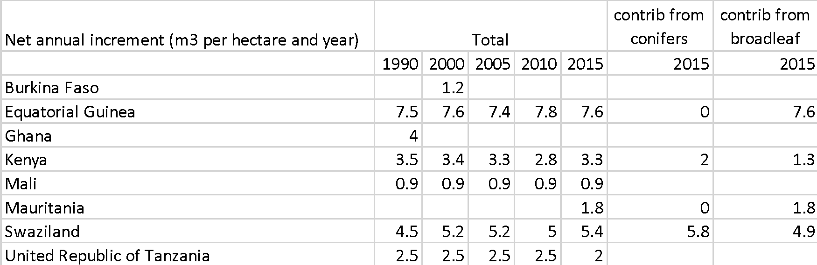
Challenges using Tool30 – misleading or ambiguous data sources
Other sources have very limited coverage. E.g. FAO’s 2015 GFRA:
Only includes 11 countries in SSA
Has no breakdown by forest type
Only conifer / broadleaf
Inconsistent presentation of data
No scientific sources cited
No uncertainty provided
From FAO’s “2015 Global Forest Resource Assessment”
Take Kenya as an example:
1.3 m³/ha-yr for broadleaf forests
< Mauritania ?!?!
0.9 dry-tons/ha-yr
lower than most IPCC data

