Slide 1
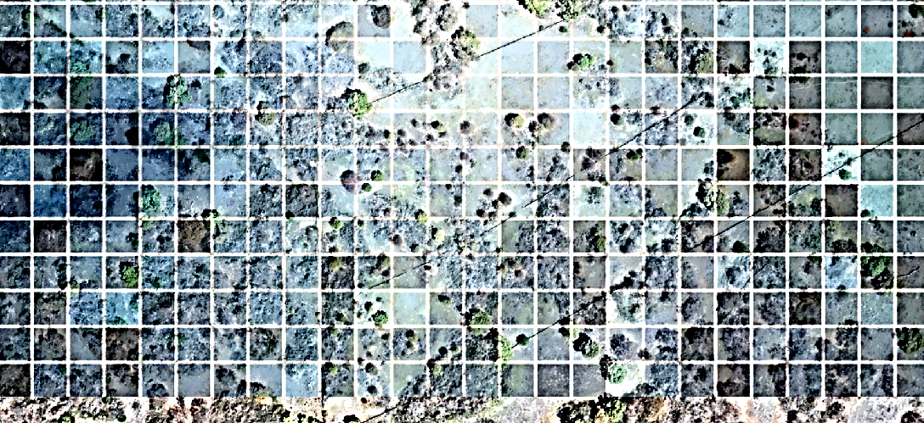





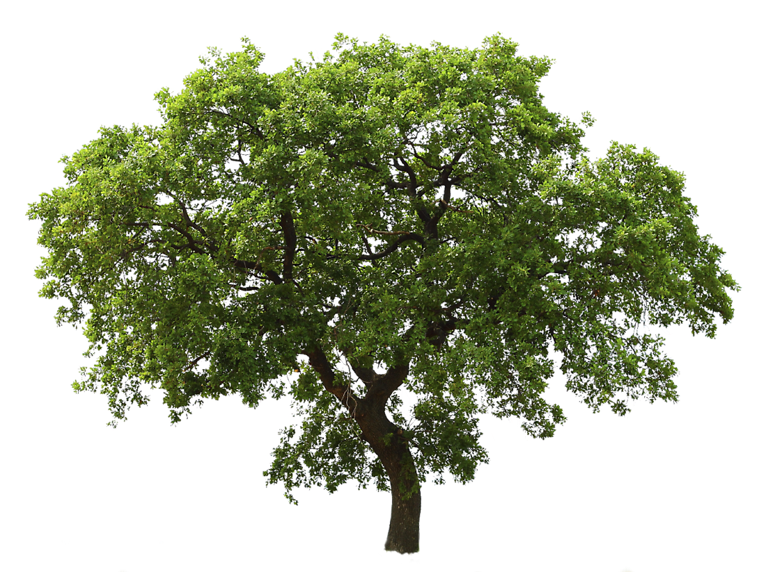

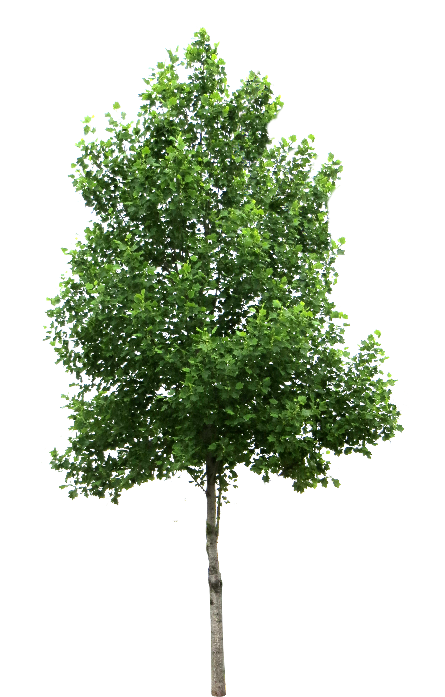

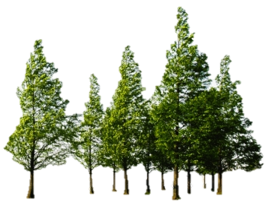

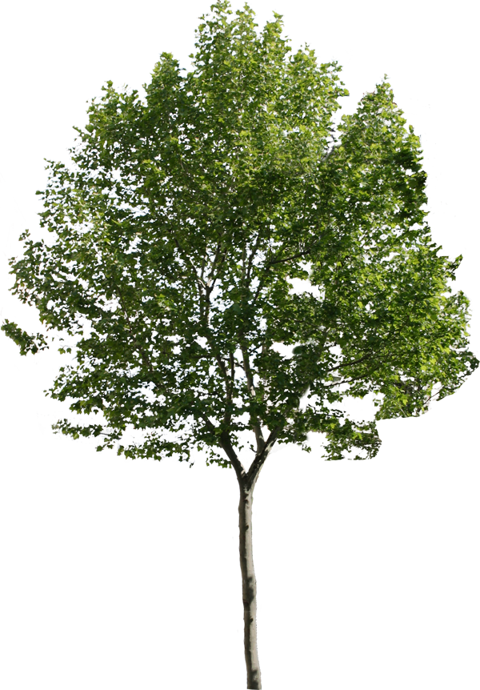
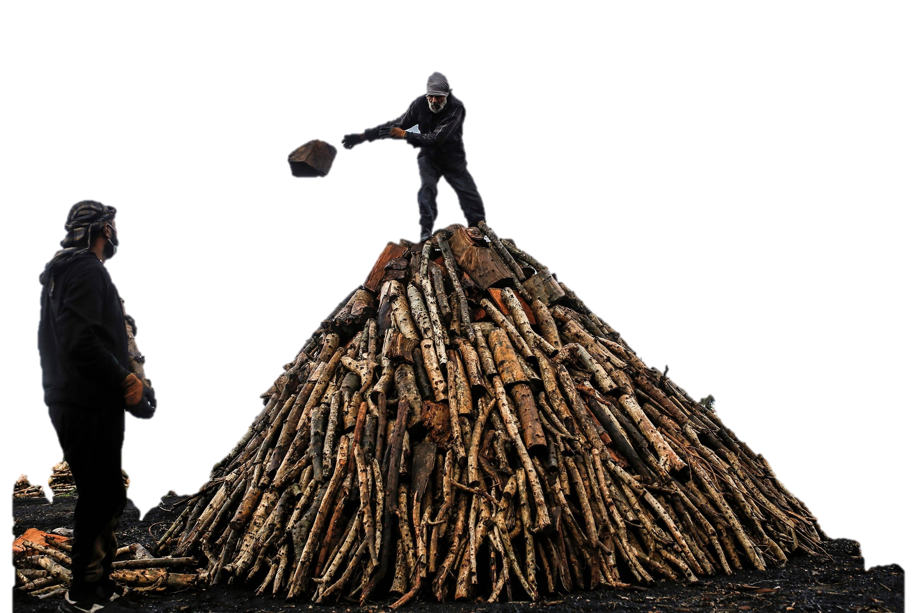
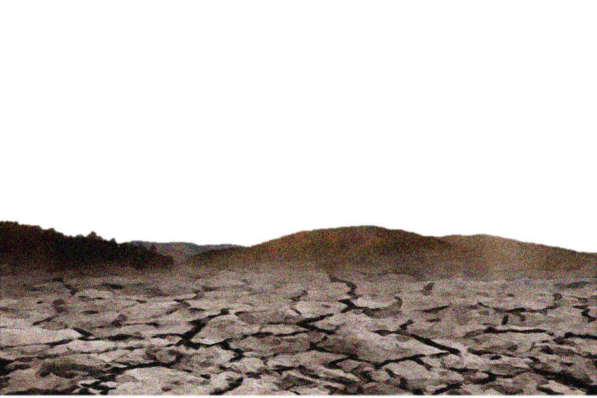
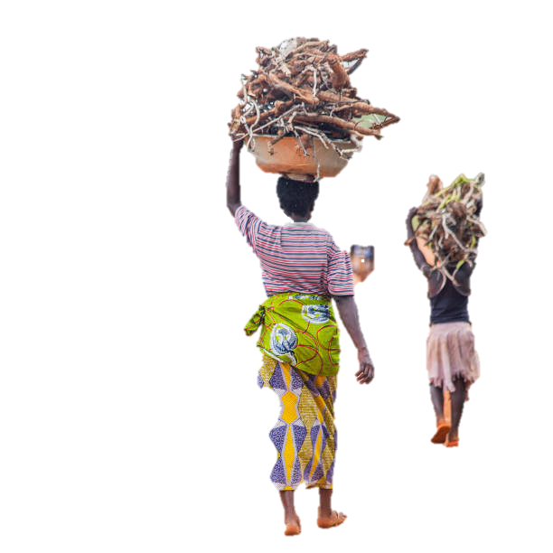





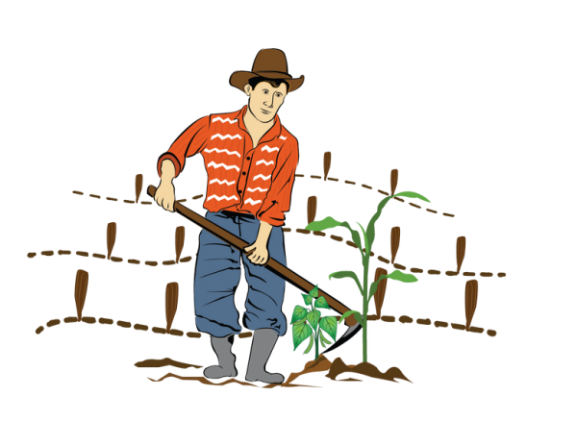
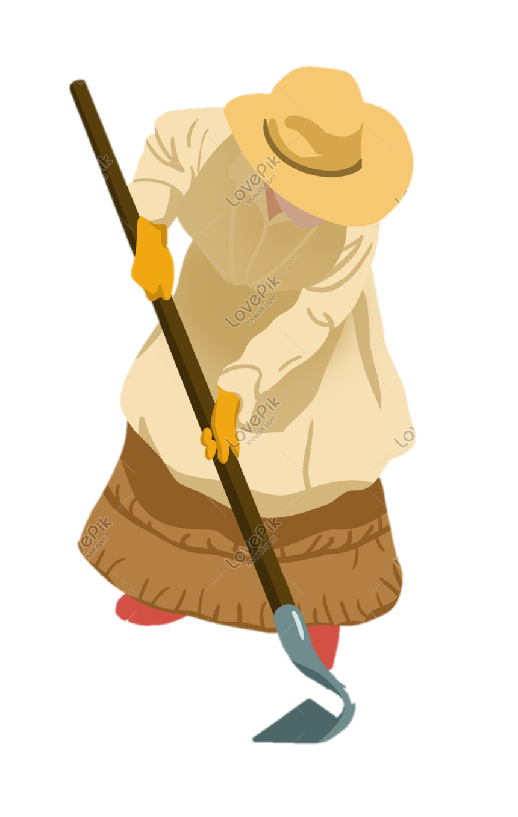
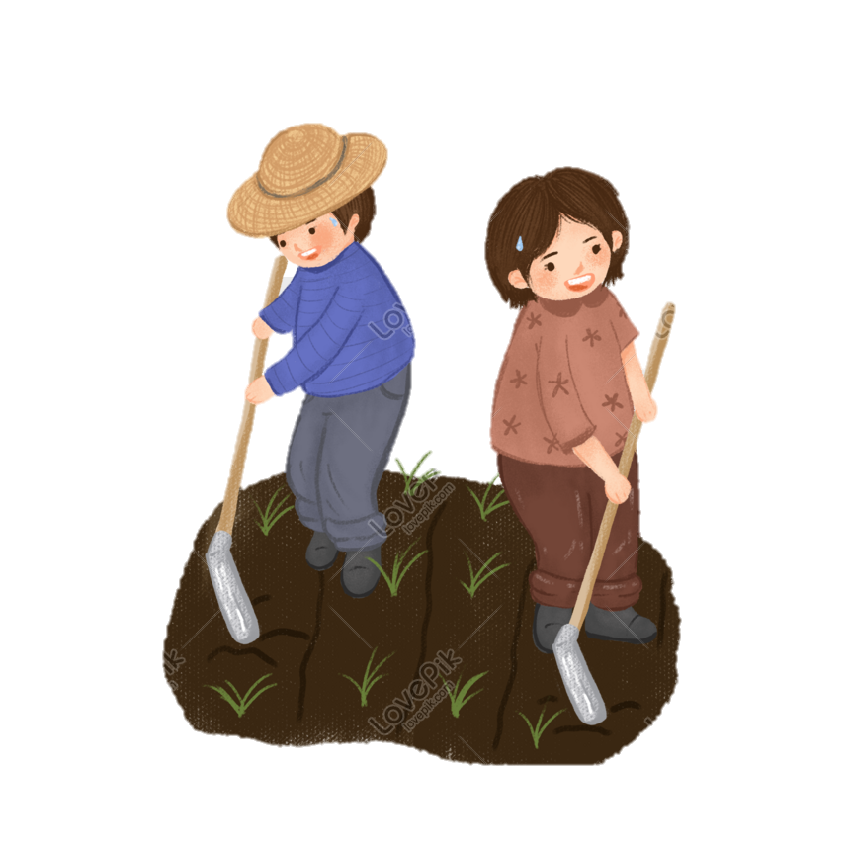
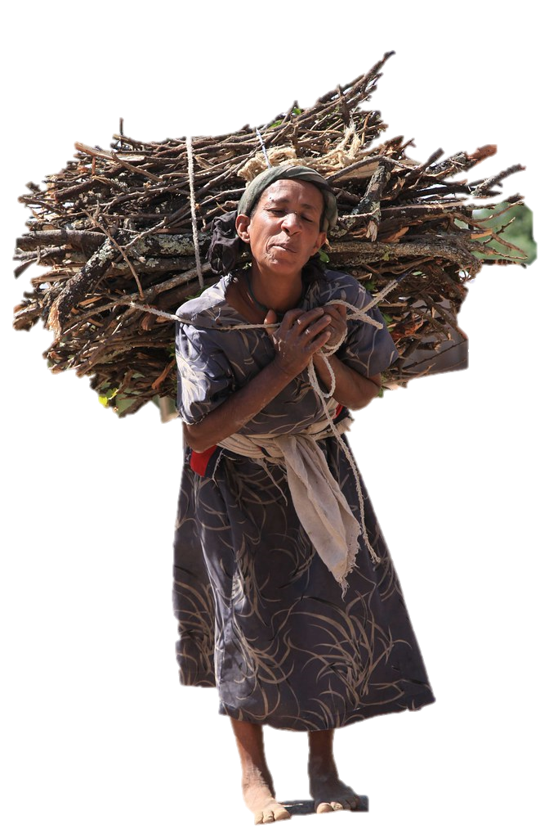
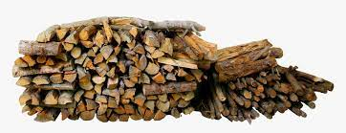

Cross-Checking Cookstove Projects' fNRB Claims with MoFuSS
Capacity Building Workshop for BeZero
London, February 11th & 12th 2025
Webpage: https://wegp.unam.mx/courses/BeZero2025 Google Meet: https://meet.google.com/ocj-yzur-uws

Slide 2
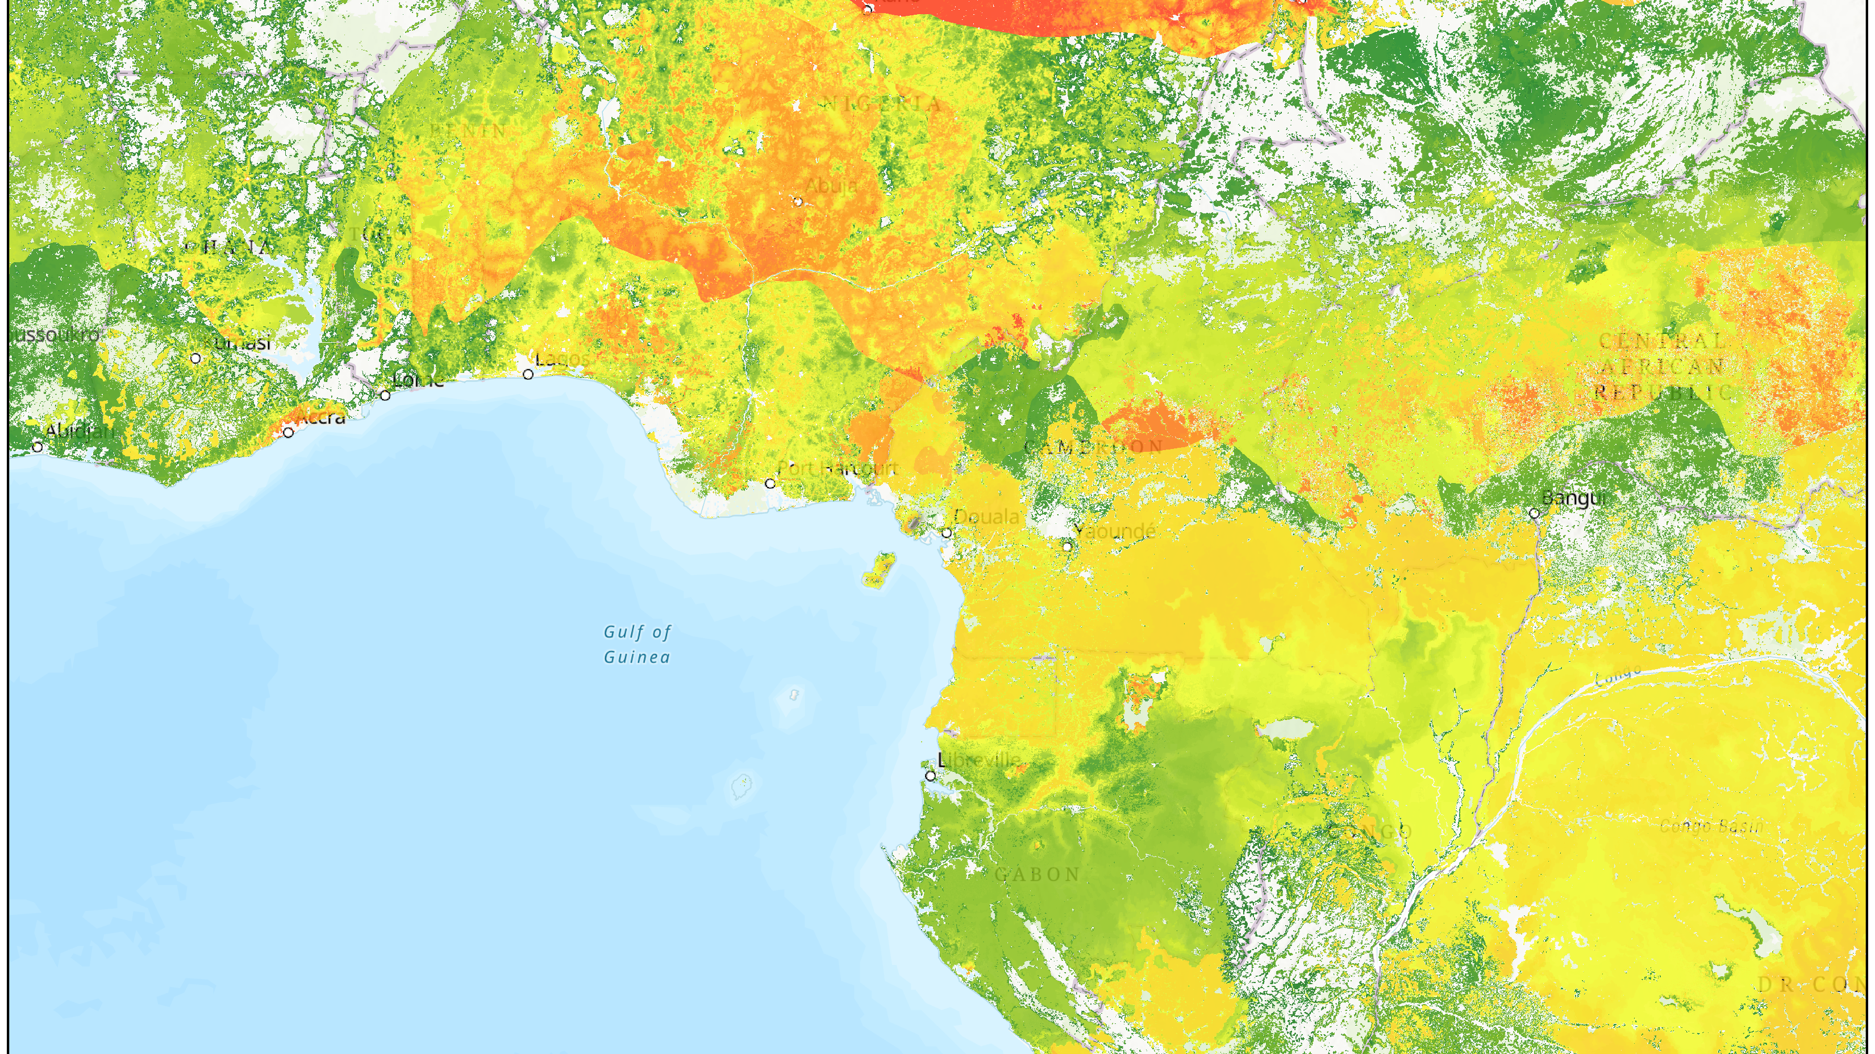
Goals
Provide tools to evaluate the credibility of fNRB claims from cookstove projects:
  Tier 1: Consulting readily available results from 1km simulations on the MoFuSS webpage.
  Tier 2: Running local simulations at 1000m as a prototype of the ongoing WebMoFuSS simulation tool, currently under development by the MoFuSS team.
For Project Developers: It serves as a resource to help calculate fNRB values within plausible ranges, grounded in observed data and geospatial simulations, leveraging nearly two decades of experience from MoFuSS researchers and developers.

Slide 3
BeZero’s questions
Should fNRB decrease each year if project is effective?
Tracking differences in fNRB overtime to enhance ratings robustness?
Explanation of BURN fNRB method and differences to MoFuSS?
What is the fNRB accuracy for commodity-based fuels like charcoal?
How can you know where fuel is sourced from?
fNRB for households which don't disclose household locations?
fNRB for households which rely mainly on harvest residue e.g. they have no impact on forest dynamics?
Should projects be claiming credits for sequestration?

Slide 4
Agenda – Day 1 (5hrs) https://wegp.unam.mx/courses/BeZero2025
Part I: Presentations and Discussion: To provide foundational knowledge and address BeZero’s questions.
  Generating Emission Reductions from Clean Cooking Interventions – Rob Bailis - SEI
  The CLEAR Methodology for Cooking Energy Transitions – Steven Pluymaekers - CCA
  Woodfuel Supply and Demand Dynamics – Adrian
  Inside MoFuSS: How the Model Works – Adrian
  BeZero’s Cookstove Rating Approach, focusing on the fNRB Parameter – Discussion and comparative analysis.
  New MoFuSS Developments for 2025 – 2026. – Adrian & Rob
Part II: Hands-On Exercise: To equip participants with practical skills for applying MoFuSS results.
  Using MoFuSS Results at 1km to Validate Cookstove Project Claims
  Practical Examples: Cross-Checking Registered Cookstove Projects
  How to Cite and Report MoFuSS Results During Ongoing Paper Publication
Part III: Pre-installation and setup with second day participants

Slide 5

Two words on workshop dynamics

